Slide 1
Determining Features for maximizing Hospital Returns from insurance Companies
Vignesh Selvakumaran, MD

Slide 2
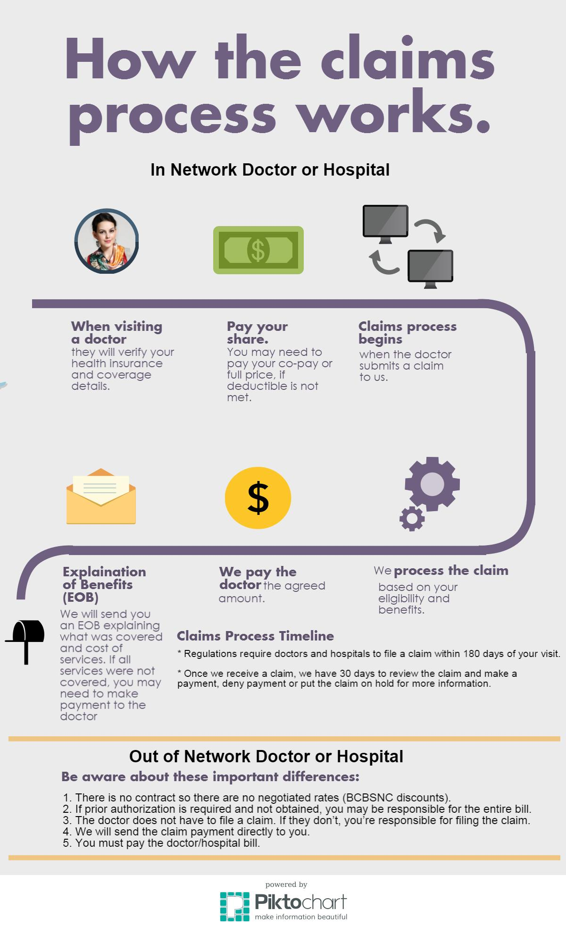
The Claims Process
Physicians are part of a group that negotiate rates with insurance providers
Patients are part of insurance groups and pay insurance providers for coverage
Every so often these rates are renegotiated, and various factors go into them
Previously insurance companies didn’t release rates for procedures for different hospitals
Change came this year.

Slide 3
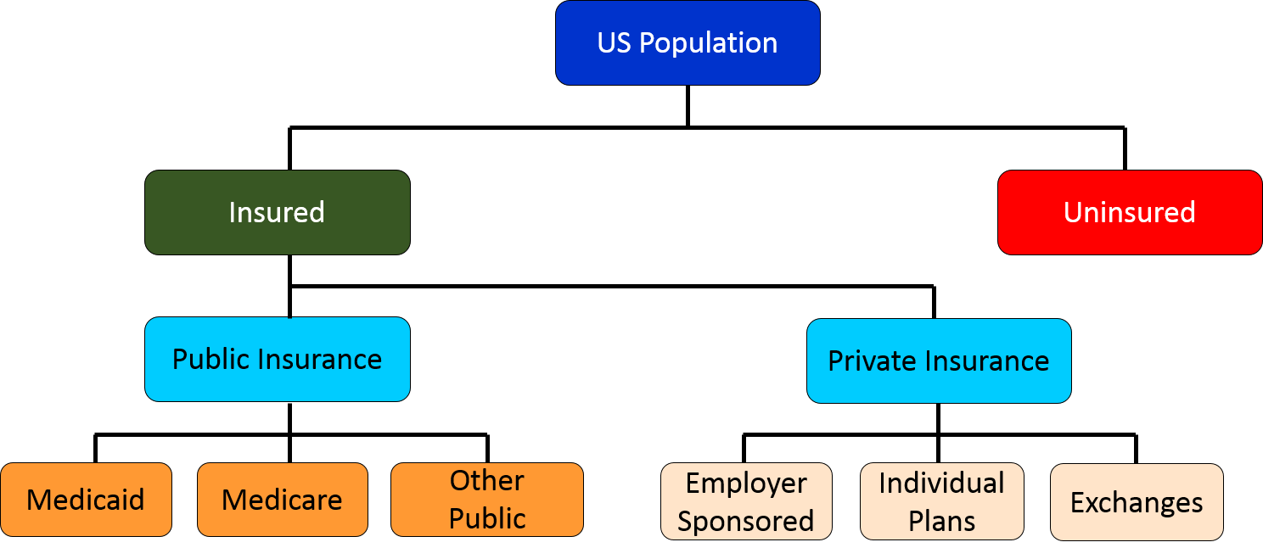
Who Cares?
Hospitals
Patients
Insurance Companies
Government (VA)

Slide 4
Find Metrics that can help Hospitals increase their reimbursement rate
Goal

Slide 5
Goal
Data:
United Healthcare Insurance Dataset(Private Insurance Company)
CMS Metric and Provider Data (Government Hospital Performance Metrics)
Method:
Match Providers and Provider Groups
Determine Negotiated Rates for procedures
Determine Procedures and Metrics to Build Model
Build the Model

Slide 6
Goal
Data:
United Healthcare Insurance Dataset(Private Insurance Company)
CMS Metric and Provider Data (Government Hospital Performance Metrics)
Method:
Match Providers and Provider Groups
Determine Negotiated Rates for procedures
Determine Procedures and Metrics to Build Model
Build the Model

Slide 7
Data Cleaning
​PROBLEM | SOLUTION
JSON Format, Multiple Files/Transactional | Ijson library in python, parsing​
Large File Sizes to Parse | Limit size of filles to 1 gig, limit number of files​
Different Values of negotiated rates of hospitals | Use the median values​
Small sample size for certain hospital/procedures | Determined procedures that had good sample size​

Slide 8
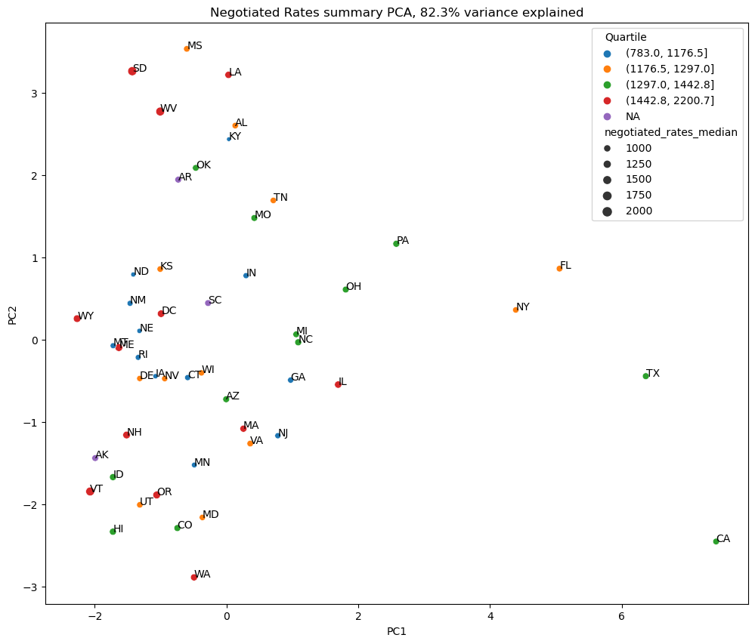
EDTA & Model
EDTA
Demand metrics(population, size of hospital)
Economic metrics(median salary, urban vs rural)
PCA looking at certain metrics was applied
Procedures with larger negotiated rates and a good sample size of different hospitals
CPT 58150 was selected, and a random Florida hospital was used to create the model
Model:
Different supervised learning were used (K-means clustering, Random Forest, Gradient boosted RF, etc)
Hyper-tuning utilized Gridsearch
Mean Absolute Percentage Error was used as the evaluation metric
Final Model: 79% accuracy, Random Forest Regressor

Slide 9
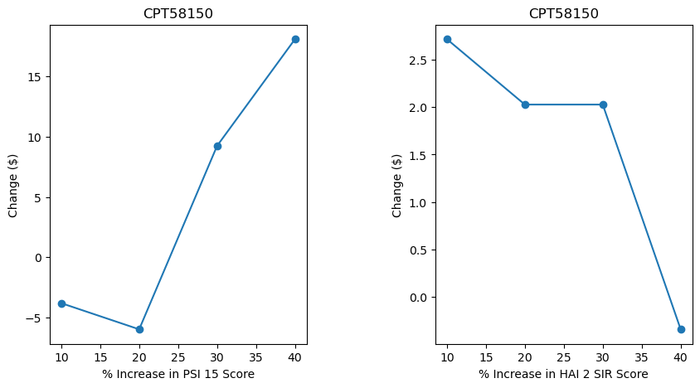
Scenarios to Try:
​SCENARIOS
Increasing either PSI 15 by a certain percentage or increase HAI 2 SIR by a certain percentage
Increase Demand by certain percentage by acquiring another hospital, either through discharge ratio/hospital days
Increase Number of Interns/Residents
Increase both PSI 15 and HAI 2 by a certain percentage

Slide 10
Improvements
Large JSON Files
Utilize Cloud Computing for Parsing
Accuracy Improvements
Utilize different Deep Learning Models, More data
Interactivity
Deploy GUI for interactivity for Hospitals,
Different Datasets
Utilize other insurance company datasets, alongside Medicare data

Slide 11
THANK YOU
Vignesh Selvakumaran
vigneshselvakumaran@gmail.com
Thanks to Springboard and Mentor Branko Kovac

